Slide 1
MindMate
THE TEAM
ELSAYED MOHAMED
DANIA MOHAMED
MAYA MOHAMED
BASMALA OSAMA
NADA FARID
NOURHAN FARID

Slide 2

THE PROBLEM:
Mental health issues are on the rise.
People often have life's traumas or stressed and don't know how to expression to people to find the help they need.
The deaf and dumb who can't express their feelings unless there is a sign language interpreter.

Slide 3

THE SOLUTION:
Create App provide an accessible and convenient way for people to start chatting your problem with chatbot based on artificial intelligence, and you will find help and solutions to your problem, and it will be your privacy and secrecy.

Slide 4
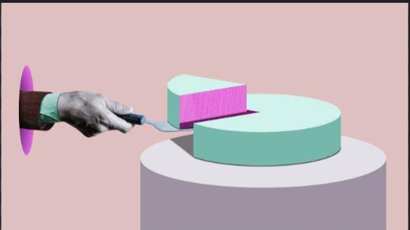
MARKET SIZE :
Mental health issues:
In Egypt around 7.5% of the Egyptian population.
In World around 10% of the world's population.
Deaf and mute:
In Egypt around 5% of the Egyptian population.
In World around 6% of the world's population.

Slide 5

COMPETITORS:
BetterHelp
Talkspace
Headspace
Calm
7 Cups
Moodfit
Pacifica
Youper
Ginger
Woebot

Slide 6
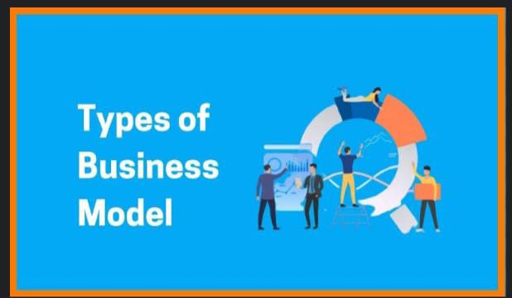
BUSINESS MODEL:
Customer Segments
Customer Relationships
Channels
Value Proposition
Key Activities
Key Resources
Key Partnerships
Revenue Streams
Cost Structure

Slide 7
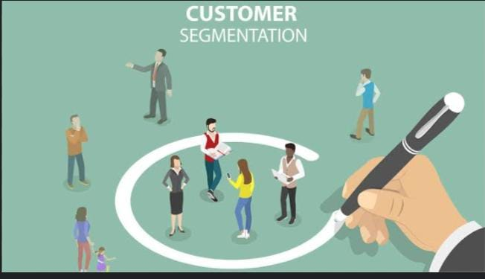
Customer Segments:
deaf and mutes
military personnel (currently or completed their service)
Students
People seeking to improve mental health in general

Slide 8
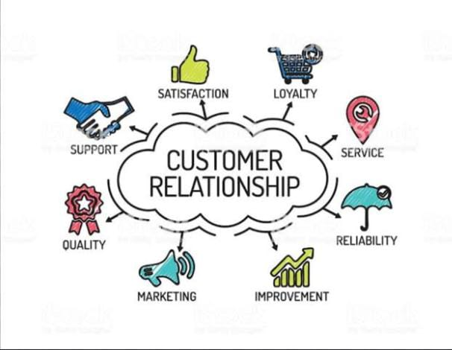
Customer Relationships:
Gather feedback and surveys from customers for evaluating responses.
Customer Service.

Slide 9
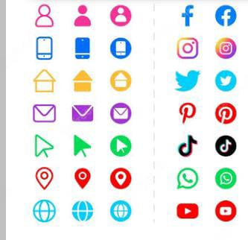
Channels:
App stores
Play stores
Social media
Website
Sharing with friends
Mental health organizations

Slide 10

Value Proposition:
Building relationships and partnerships with mental health professionals and organizations to offer the best support to users.
Developing the chatbot based on user feedback:
improve designing the chatbot's conversational.
integrating NLP algorithms.
testing the chatbot's functionality such as camera.
Providing user support to receive their problems

Slide 11

Key Resources:
Natural Language Processing (NLP) tools and software for understanding and responding to user queries.
Cloud computing resources for hosting the chatbot and ensuring it can handle high volumes of traffic and data.

Slide 12

Key Partnerships:
Mental health organizations
Psychotherapist.

Slide 13

Revenue Streams:
subscription service in range: 2 to 7 dollars .
Advertising in range: 0.33 to 1.6 dollars per click.

Slide 14

Cost Structure:
licensing fees for software: 25$ to 170$ .
advertising cost in range 30$ to 170$.

Slide 15


